Slide 1
Create Db
Notes:
USE [master]
GO
CREATE DATABASE [RestaurantDelivery]
CONTAINMENT = NONE
ON PRIMARY
( NAME = N'RestaurantDelivery', FILENAME = N'C:\Users\thiag\RestaurantDelivery.mdf' , SIZE = 8192KB , MAXSIZE = UNLIMITED, FILEGROWTH = 65536KB )
LOG ON
( NAME = N'RestaurantDelivery_log', FILENAME = N'C:\Users\thiag\RestaurantDelivery_log.ldf' , SIZE = 8192KB , MAXSIZE = 2048GB , FILEGROWTH = 65536KB )
GO
ALTER DATABASE [RestaurantDelivery] SET COMPATIBILITY_LEVEL = 130
GO
IF (1 = FULLTEXTSERVICEPROPERTY('IsFullTextInstalled'))
begin
EXEC [RestaurantDelivery].[dbo].[sp_fulltext_database] @action = 'enable'
end
GO
ALTER DATABASE [RestaurantDelivery] SET ANSI_NULL_DEFAULT OFF
GO
ALTER DATABASE [RestaurantDelivery] SET ANSI_NULLS OFF
GO
ALTER DATABASE [RestaurantDelivery] SET ANSI_PADDING OFF
GO
ALTER DATABASE [RestaurantDelivery] SET ANSI_WARNINGS OFF
GO
ALTER DATABASE [RestaurantDelivery] SET ARITHABORT OFF
GO
ALTER DATABASE [RestaurantDelivery] SET AUTO_CLOSE ON
GO
ALTER DATABASE [RestaurantDelivery] SET AUTO_SHRINK OFF
GO
ALTER DATABASE [RestaurantDelivery] SET AUTO_UPDATE_STATISTICS ON
GO
ALTER DATABASE [RestaurantDelivery] SET CURSOR_CLOSE_ON_COMMIT OFF
GO
ALTER DATABASE [RestaurantDelivery] SET CURSOR_DEFAULT GLOBAL
GO
ALTER DATABASE [RestaurantDelivery] SET CONCAT_NULL_YIELDS_NULL OFF
GO
ALTER DATABASE [RestaurantDelivery] SET NUMERIC_ROUNDABORT OFF
GO
ALTER DATABASE [RestaurantDelivery] SET QUOTED_IDENTIFIER OFF
GO
ALTER DATABASE [RestaurantDelivery] SET RECURSIVE_TRIGGERS OFF
GO
ALTER DATABASE [RestaurantDelivery] SET ENABLE_BROKER
GO
ALTER DATABASE [RestaurantDelivery] SET AUTO_UPDATE_STATISTICS_ASYNC OFF
GO
ALTER DATABASE [RestaurantDelivery] SET DATE_CORRELATION_OPTIMIZATION OFF
GO
ALTER DATABASE [RestaurantDelivery] SET TRUSTWORTHY OFF
GO
ALTER DATABASE [RestaurantDelivery] SET ALLOW_SNAPSHOT_ISOLATION OFF
GO
ALTER DATABASE [RestaurantDelivery] SET PARAMETERIZATION SIMPLE
GO
ALTER DATABASE [RestaurantDelivery] SET READ_COMMITTED_SNAPSHOT ON
GO
ALTER DATABASE [RestaurantDelivery] SET HONOR_BROKER_PRIORITY OFF
GO
ALTER DATABASE [RestaurantDelivery] SET RECOVERY SIMPLE
GO
ALTER DATABASE [RestaurantDelivery] SET MULTI_USER
GO
ALTER DATABASE [RestaurantDelivery] SET PAGE_VERIFY CHECKSUM
GO
ALTER DATABASE [RestaurantDelivery] SET DB_CHAINING OFF
GO
ALTER DATABASE [RestaurantDelivery] SET FILESTREAM( NON_TRANSACTED_ACCESS = OFF )
GO
ALTER DATABASE [RestaurantDelivery] SET TARGET_RECOVERY_TIME = 60 SECONDS
GO
ALTER DATABASE [RestaurantDelivery] SET DELAYED_DURABILITY = DISABLED
GO
ALTER DATABASE [RestaurantDelivery] SET QUERY_STORE = OFF
GO
USE [RestaurantDelivery]
GO
ALTER DATABASE SCOPED CONFIGURATION SET LEGACY_CARDINALITY_ESTIMATION = OFF;
GO
ALTER DATABASE SCOPED CONFIGURATION SET MAXDOP = 0;
GO
ALTER DATABASE SCOPED CONFIGURATION SET PARAMETER_SNIFFING = ON;
GO
ALTER DATABASE SCOPED CONFIGURATION SET QUERY_OPTIMIZER_HOTFIXES = OFF;
GO
ALTER DATABASE [RestaurantDelivery] SET READ_WRITE
GO
CREATE TABLE [dbo].[MenuItem](
[IdMenuItem] [int] IDENTITY(1,1) NOT NULL,
[IdRestaurant] [int] NOT NULL,
[ItemName] [varchar](30) NULL,
[ItemDescription] [varchar](50) NULL,
[ItemPrice] [decimal](18, 0) NULL,
CONSTRAINT [PK_MenuItems] PRIMARY KEY CLUSTERED
(
[IdMenuItem] ASC
)WITH (PAD_INDEX = OFF, STATISTICS_NORECOMPUTE = OFF, IGNORE_DUP_KEY = OFF, ALLOW_ROW_LOCKS = ON, ALLOW_PAGE_LOCKS = ON) ON [PRIMARY]
) ON [PRIMARY]
GO
/****** Object: Table [dbo].[Order] Script Date: 8/22/2019 2:41:16 PM ******/
SET ANSI_NULLS ON
GO
SET QUOTED_IDENTIFIER ON
GO
CREATE TABLE [dbo].[Order](
[IdOrder] [int] NOT NULL IDENTITY,
[IdRestaurant] [int] NOT NULL,
[IdMenuItem] [int] NOT NULL,
[CustomerName] [varchar](30) NULL,
[CustomerAddress] [varchar](50) NULL,
[OrderNetAmount] [decimal](18, 0) NULL,
[OrderTax] [decimal](18, 0) NULL,
[OrderGrossAmount] [decimal](18, 0) NULL,
[CustomerNotes] [varchar](2000) NULL,
CONSTRAINT [PK_Orders] PRIMARY KEY CLUSTERED
(
[IdOrder] ASC
)WITH (PAD_INDEX = OFF, STATISTICS_NORECOMPUTE = OFF, IGNORE_DUP_KEY = OFF, ALLOW_ROW_LOCKS = ON, ALLOW_PAGE_LOCKS = ON) ON [PRIMARY]
) ON [PRIMARY]
GO
/****** Object: Table [dbo].[Restaurant] Script Date: 8/22/2019 2:41:16 PM ******/
SET ANSI_NULLS ON
GO
SET QUOTED_IDENTIFIER ON
GO
CREATE TABLE [dbo].[Restaurant](
[IdRestaurant] [int] IDENTITY(1,1) NOT NULL,
[Name] [varchar](30) NULL,
[Address] [nvarchar](50) NULL,
[Description] [varchar](1000) NULL,
[Cuisine] [nvarchar](30) NULL,
[Image] [varbinary](max) NULL,
CONSTRAINT [PK_Restaurants] PRIMARY KEY CLUSTERED
(
[IdRestaurant] ASC
)WITH (PAD_INDEX = OFF, STATISTICS_NORECOMPUTE = OFF, IGNORE_DUP_KEY = OFF, ALLOW_ROW_LOCKS = ON, ALLOW_PAGE_LOCKS = ON) ON [PRIMARY]
) ON [PRIMARY] TEXTIMAGE_ON [PRIMARY]
GO
ALTER TABLE [dbo].[MenuItem] WITH CHECK ADD CONSTRAINT [FK_MenuItems_Restaurants] FOREIGN KEY([IdRestaurant])
REFERENCES [dbo].[Restaurant] ([IdRestaurant])
GO
ALTER TABLE [dbo].[MenuItem] CHECK CONSTRAINT [FK_MenuItems_Restaurants]
GO
ALTER TABLE [dbo].[Order] WITH CHECK ADD CONSTRAINT [FK_Orders_MenuItems] FOREIGN KEY([IdMenuItem])
REFERENCES [dbo].[MenuItem] ([IdMenuItem])
GO
ALTER TABLE [dbo].[Order] CHECK CONSTRAINT [FK_Orders_MenuItems]
GO
ALTER TABLE [dbo].[Order] WITH CHECK ADD CONSTRAINT [FK_Orders_Restaurants] FOREIGN KEY([IdRestaurant])
REFERENCES [dbo].[Restaurant] ([IdRestaurant])
GO
ALTER TABLE [dbo].[Order] CHECK CONSTRAINT [FK_Orders_Restaurants]
GO
insert into Restaurant
values('Nice Place','Nice Street','All you can eat','Variety',null)
--seed menu items
insert into MenuItem
values(1,'Water','Awsome water',0.0)
insert into MenuItem
values(1,'Orange Juice','Fresh made every day', 2.5)
insert into MenuItem
values(1,'Pop','Ask for available brands', 2.0)
insert into MenuItem
values(1,'Fries','Fresh cut fries', 4.5)
insert into MenuItem
values(1,'Nachos','Served with grilled cheese and jalapenho', 2.5)
insert into MenuItem
values(1,'Perogies','Salted with black pepper and bechamel sauce.', 5.0)
insert into MenuItem
values(1,'Beyond meat burger','Generous beyond meat burger carefully seasoned', 9.5)
insert into MenuItem
values(1,'Vegetarian Poutine','Our fresh fries and the secret house gravy', 8.5)
insert into MenuItem
values(1,'Cheese Salad','Leaves mix with fresh parmisan cheese and feta',7.0)

Slide 2
Start Project
Notes:
Install-Package Microsoft.EntityFrameworkCore.Tools

Slide 3
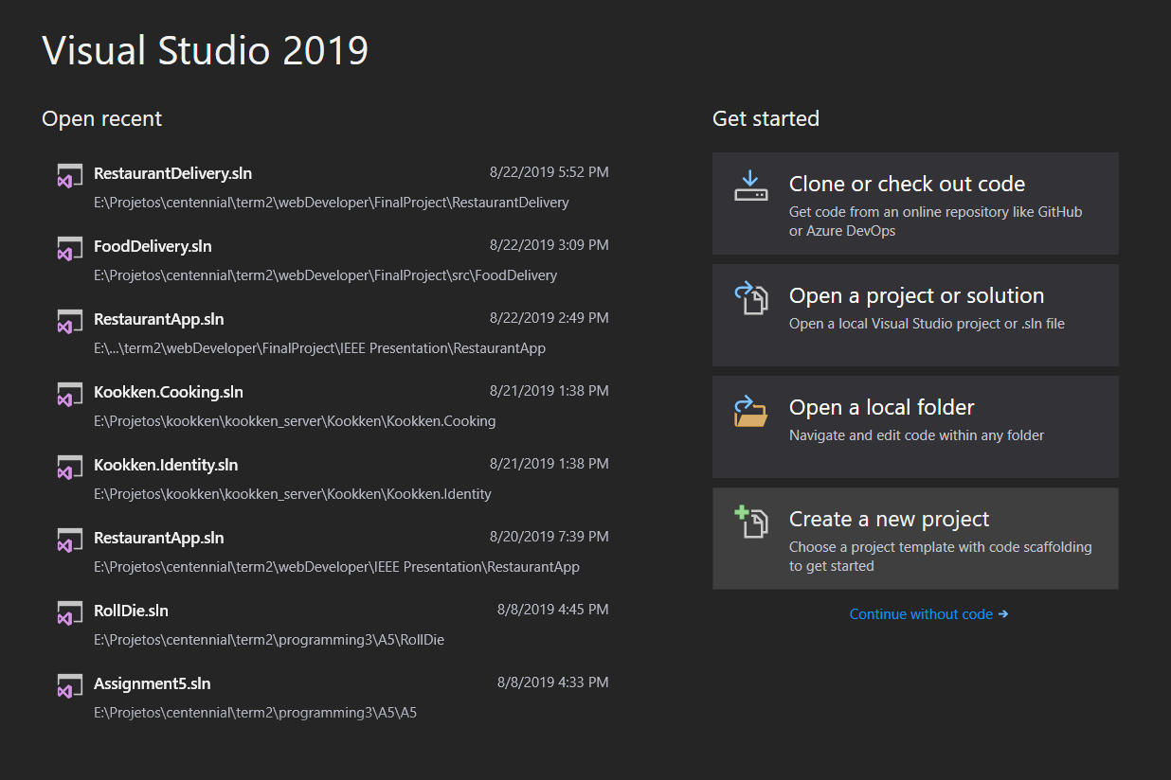

Slide 4
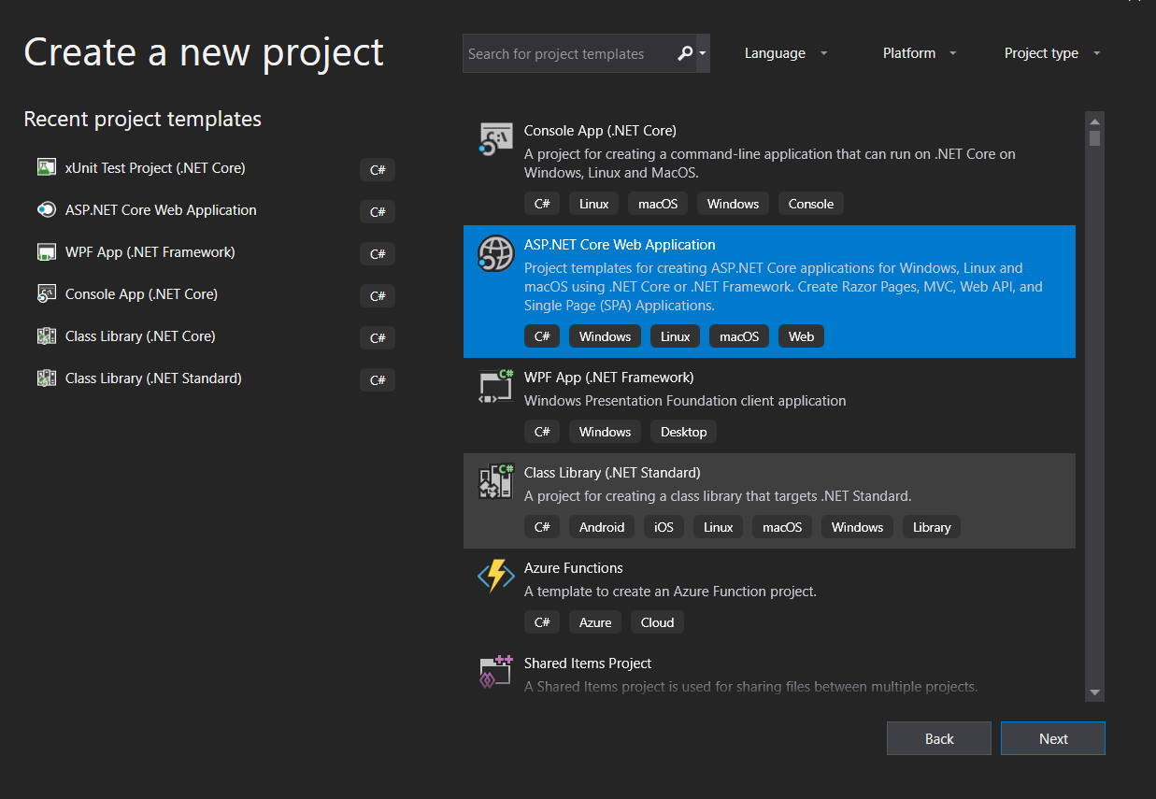

Slide 5
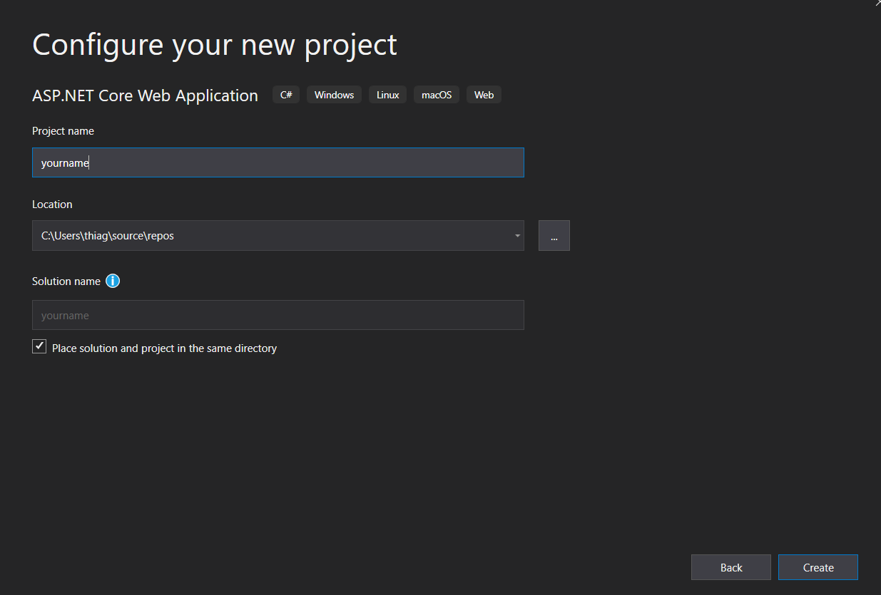

Slide 6
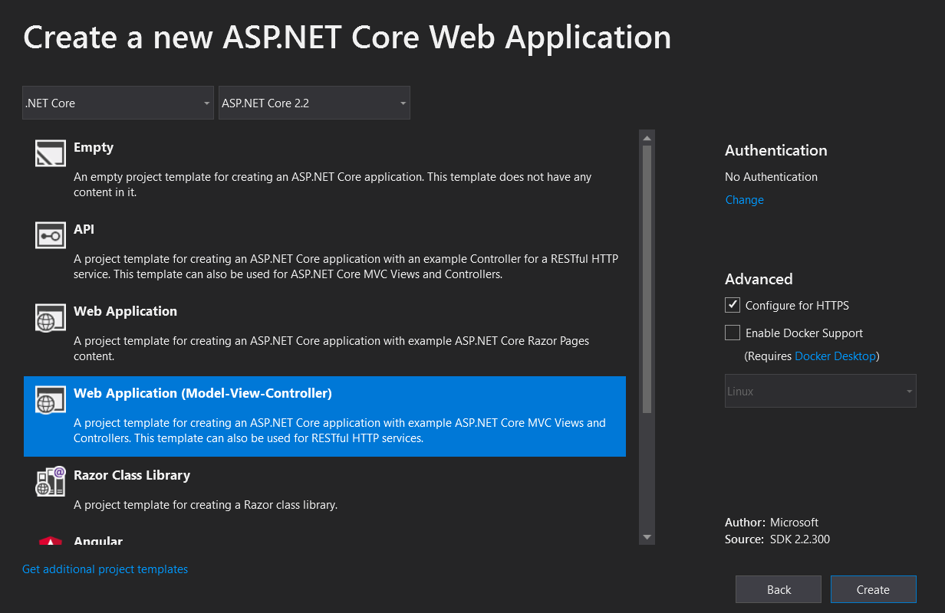

Slide 7
Scaffold Models
Notes:
Scaffold-DbContext -Context RestaurantContext "Data Source=(localdb)\MSSQLLocalDB;Initial Catalog=RestaurantDelivery;" Microsoft.EntityFrameworkCore.SqlServer -OutputDir Models -Tables Restaurant,Order,MenuItem -f

Slide 8
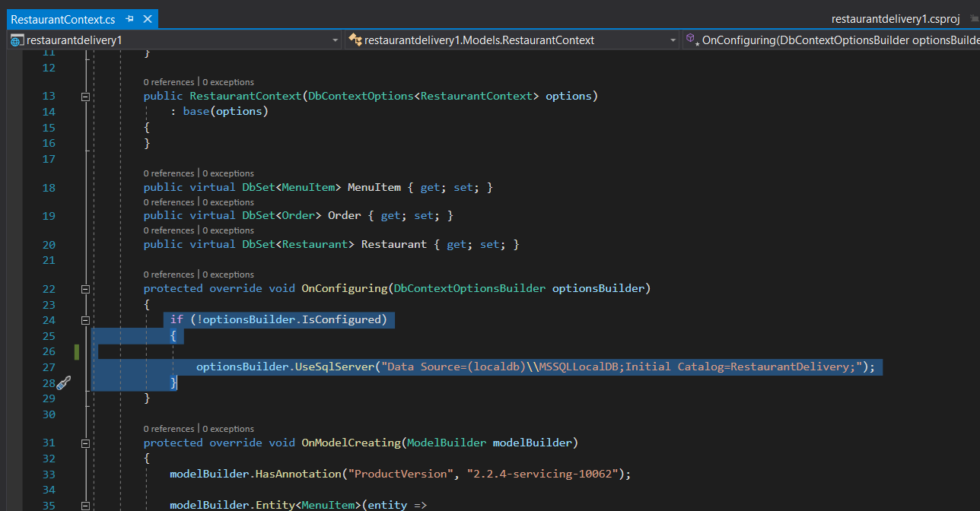

Slide 9
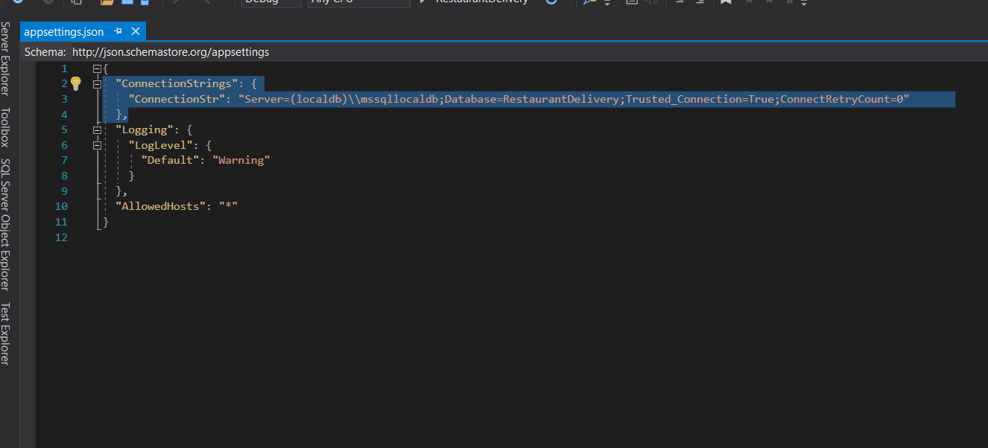
Notes:
"ConnectionStrings": {
"ConnectionStr": "Server=(localdb)\\mssqllocaldb;Database=RestaurantDelivery;Trusted_Connection=True;ConnectRetryCount=0"
},

Slide 10
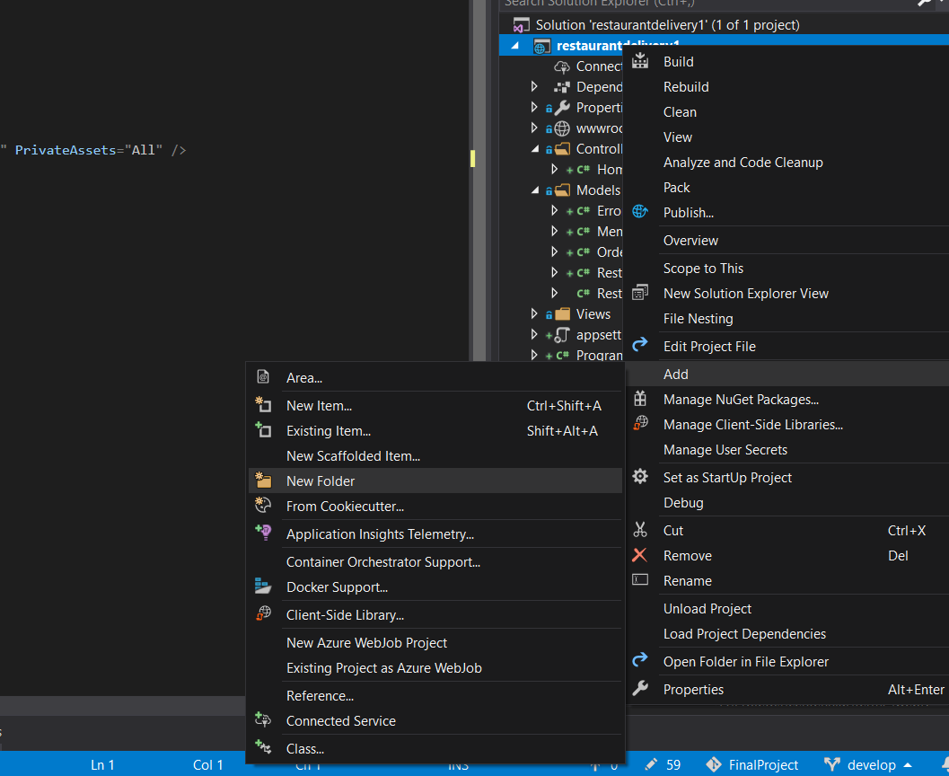

Slide 11
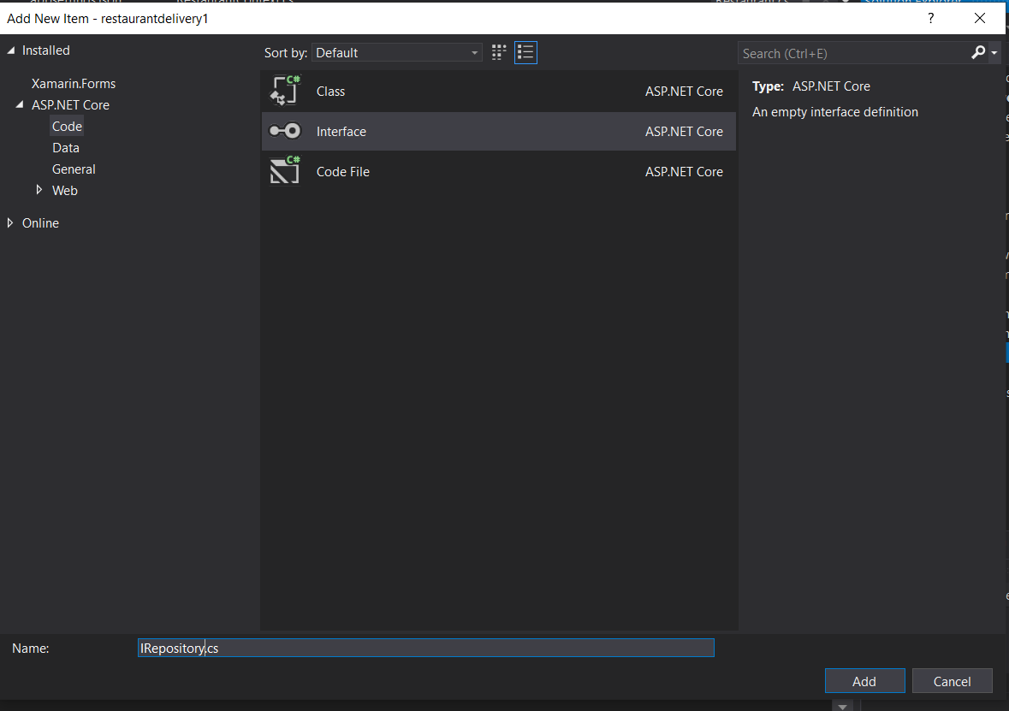
Notes:
using System;
using System.Collections.Generic;
using System.Linq;
using System.Threading.Tasks;
namespace RestaurantDelivery.Repository
{
public interface IRepository<T>
{
Task<IQueryable<T>> GetAll();
Task<T> GetById(int? Id);
Task<T> Add(T entity);
Task Remove(int? Id);
Task Update(T entity);
}
}

Slide 12
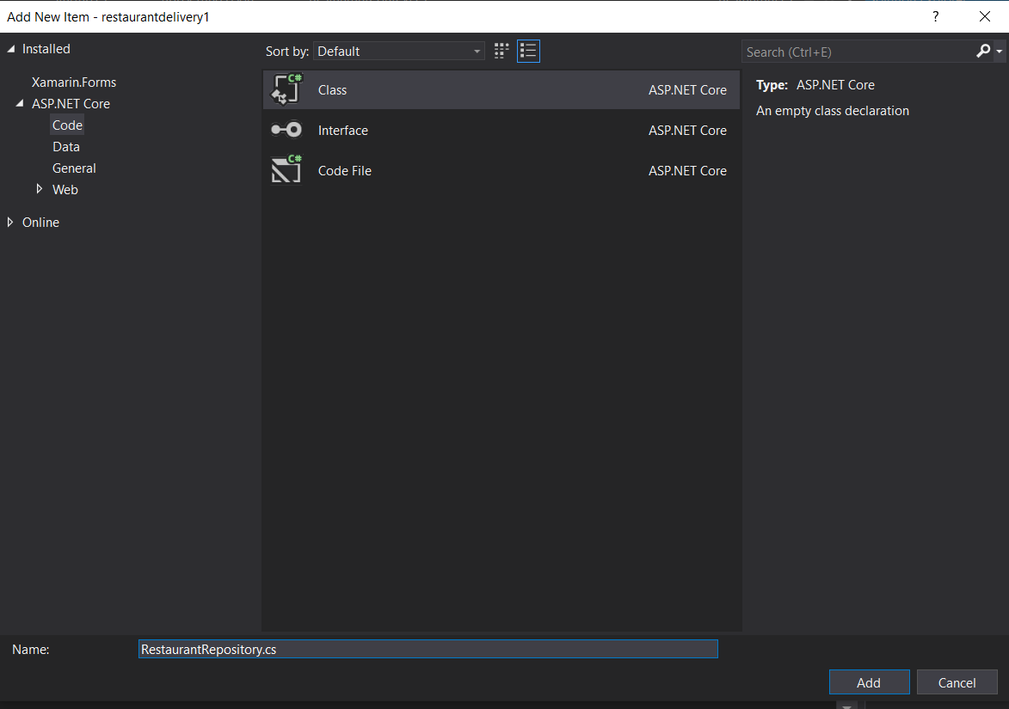
Notes:
using Microsoft.EntityFrameworkCore;
using RestaurantDelivery.Models;
using System;
using System.Collections.Generic;
using System.Linq;
using System.Threading.Tasks;
namespace RestaurantDelivery.Repository
{
public class RestaurantRepository : IRepository<Restaurant>
{
RestaurantDeliveryContext _repository;
public RestaurantRepository(RestaurantDeliveryContext repository)
{
_repository = repository;
}
public async Task<IQueryable<Restaurant>> GetAll() =>
await Task.FromResult(_repository.Restaurant
.Include(res => res.MenuItem)
//.ThenInclude(menu => menu.RestaurantMenuItem) //Intellisense issue https://github.com/dotnet/roslyn/issues/8237
);
public async Task<Restaurant> Add(Restaurant entity)
{
await _repository.AddAsync(entity);
_repository.SaveChanges();
return entity;
}
public async Task<Restaurant> GetById(int? Id)
{
return await _repository.Restaurant
.SingleOrDefaultAsync(item => item.IdRestaurant == Id.Value);
}
public async Task Remove(int? Id)
{
var customer = await GetById(Id);
_repository.Restaurant.Remove(customer);
await _repository.SaveChangesAsync();
}
public async Task Update(Restaurant entity)
{
_repository.Update(entity);
await _repository.SaveChangesAsync();
}
}
}

Slide 13
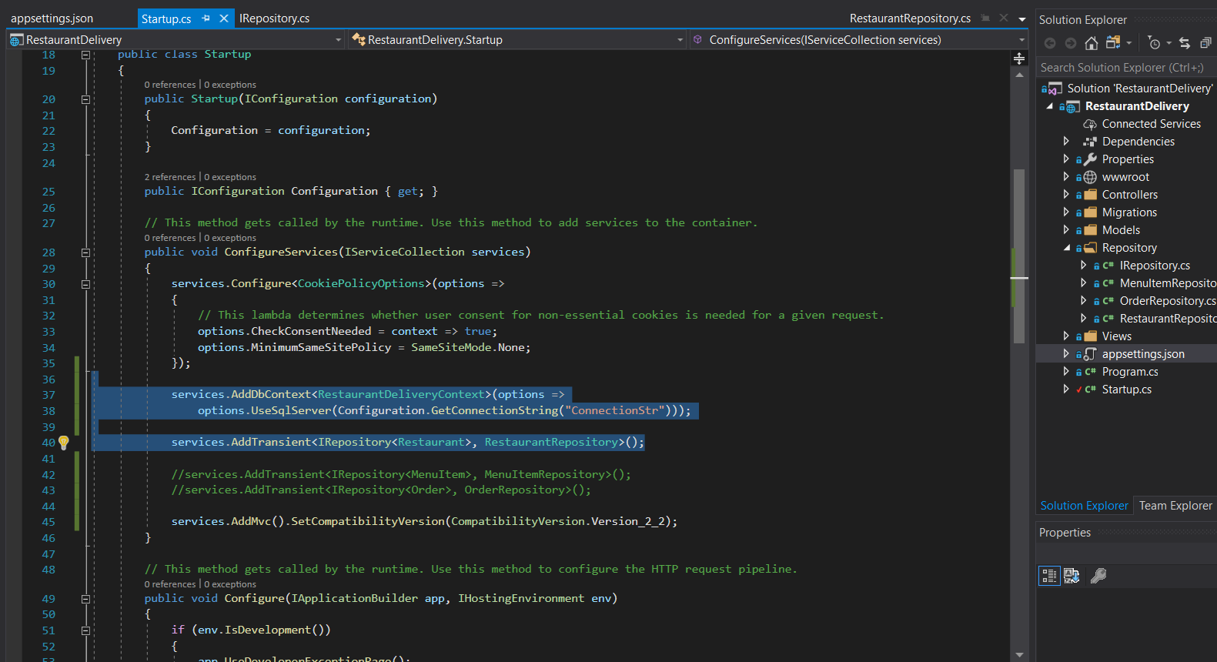
Notes:
services.AddDbContext<RestaurantDeliveryContext>(options =>
options.UseSqlServer(Configuration.GetConnectionString("ConnectionStr")));
services.AddTransient<IRepository<Restaurant>, RestaurantRepository>();

Slide 14
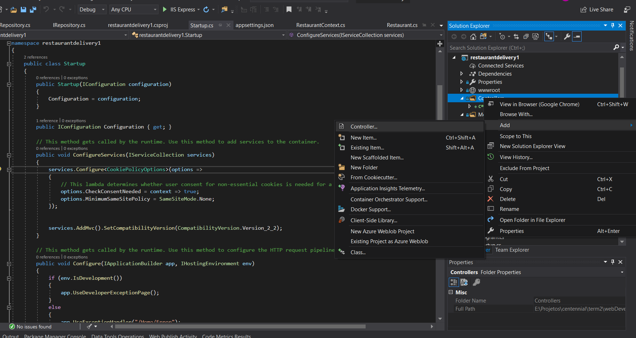

Slide 15
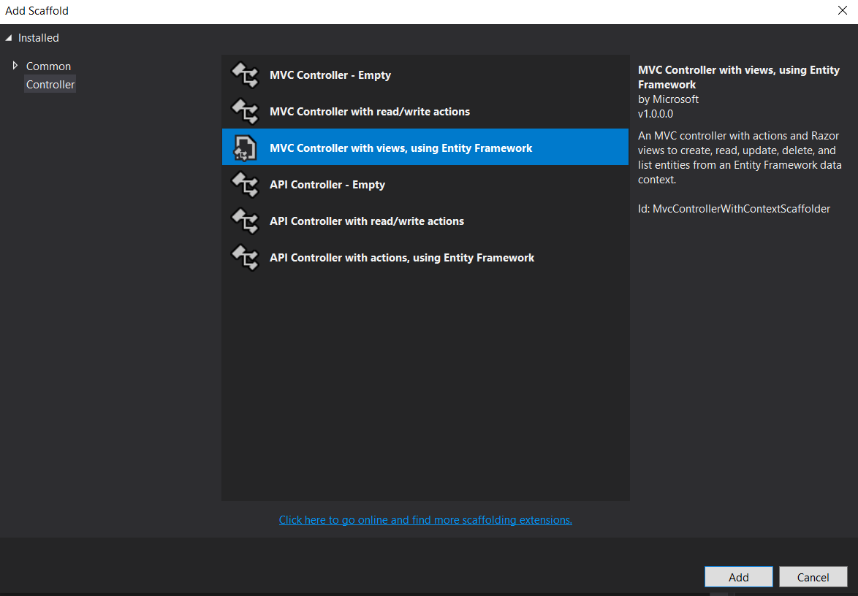

Slide 16
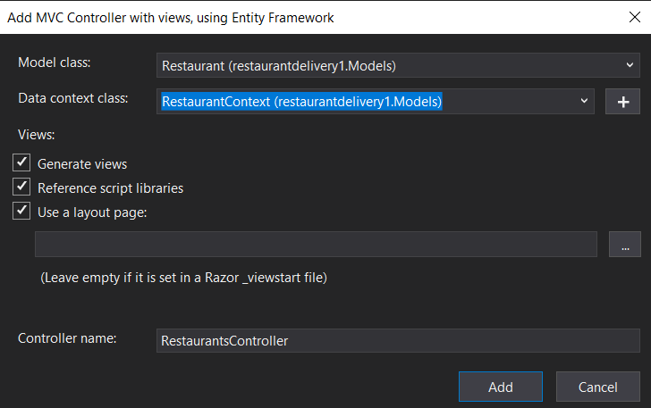

Slide 17
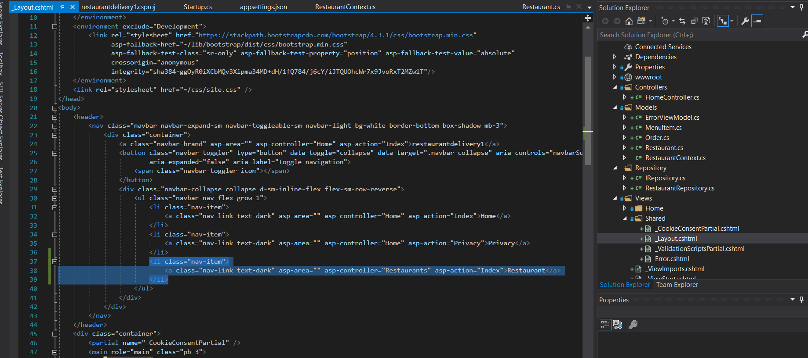
Notes:
<li class="nav-item">
<a class="nav-link text-dark" asp-area="" asp-controller="Restaurants" asp-action="Index">Restaurant</a>
</li>

Slide 18


Slide 19
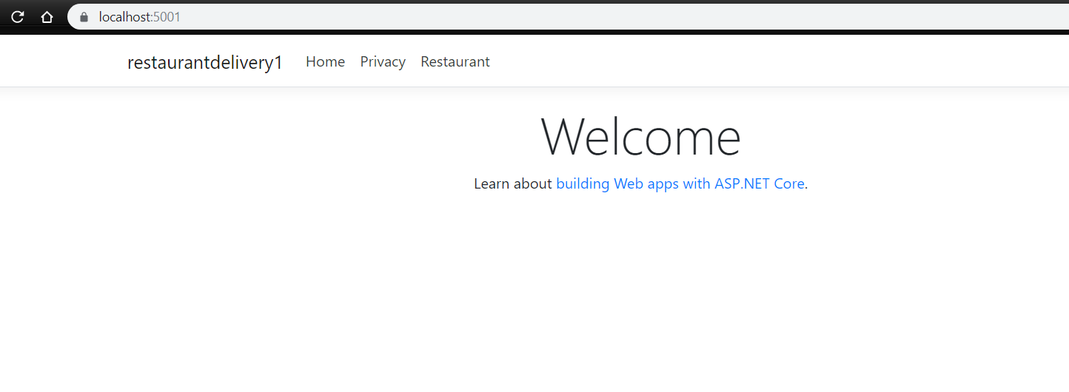

Slide 20
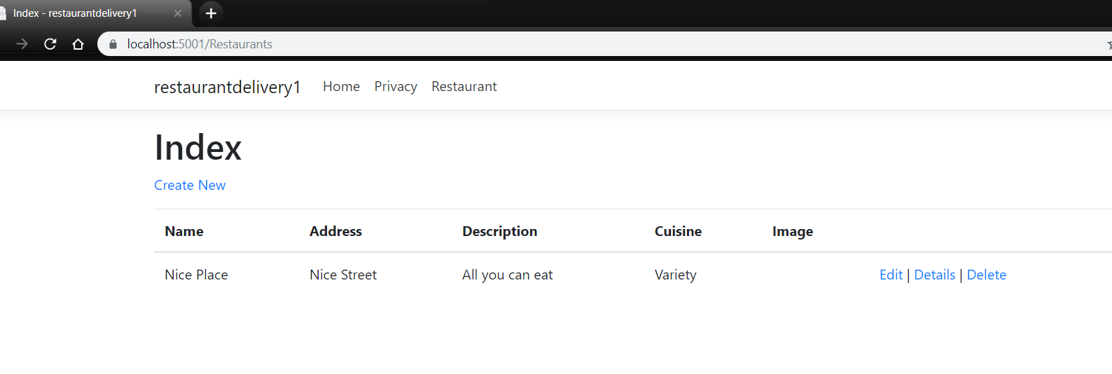

Slide 21
Add image upload funcionality

Slide 22
Beautify

